Slide 1






LA Crime Data Analysis Diya Baldota - 002747966 Veenadharini Shukla - 002704948

Slide 2
Background & Goal
Crime continues to be a significant issue in many cities around the world, including Los Angeles
Increase in various forms of crime, such as theft, assault, and homicide, place a heavy burden on resources and public safety infrastructure
Thoroughly analyze the LA Crime dataset to gain a comprehensive understanding of crime patterns and trends
Identify the underlying factors that contribute to crime in Los Angeles
Develop predictive models that can estimate the likelihood of certain crimes occurring in different areas
Utilize time series analysis techniques to predict crime trends over time
Provide data-driven insights that can support evidence-based decision-making for crime prevention and intervention in Los Angeles

Slide 3

Methodology
Data Acquisition
Data Cleaning and Pre-processing
Exploratory Data Analysis
Time Series Analysis
Feature Engineering
Model Selection
Conclusion

Slide 4
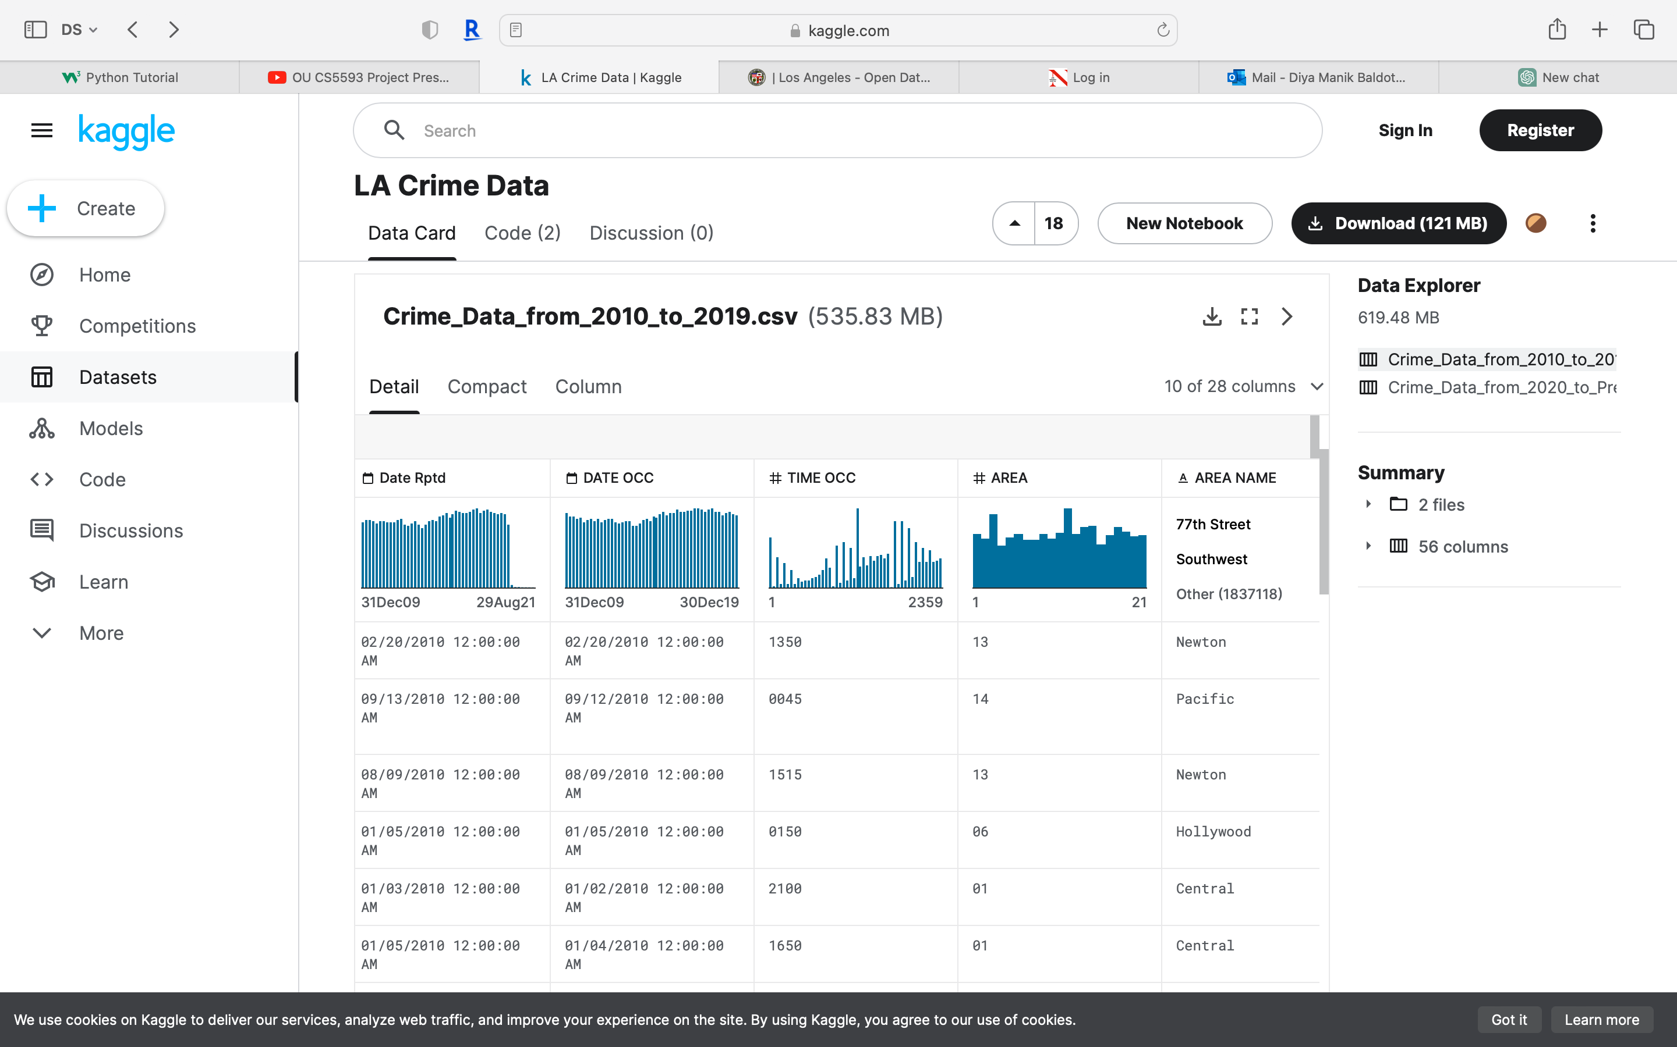
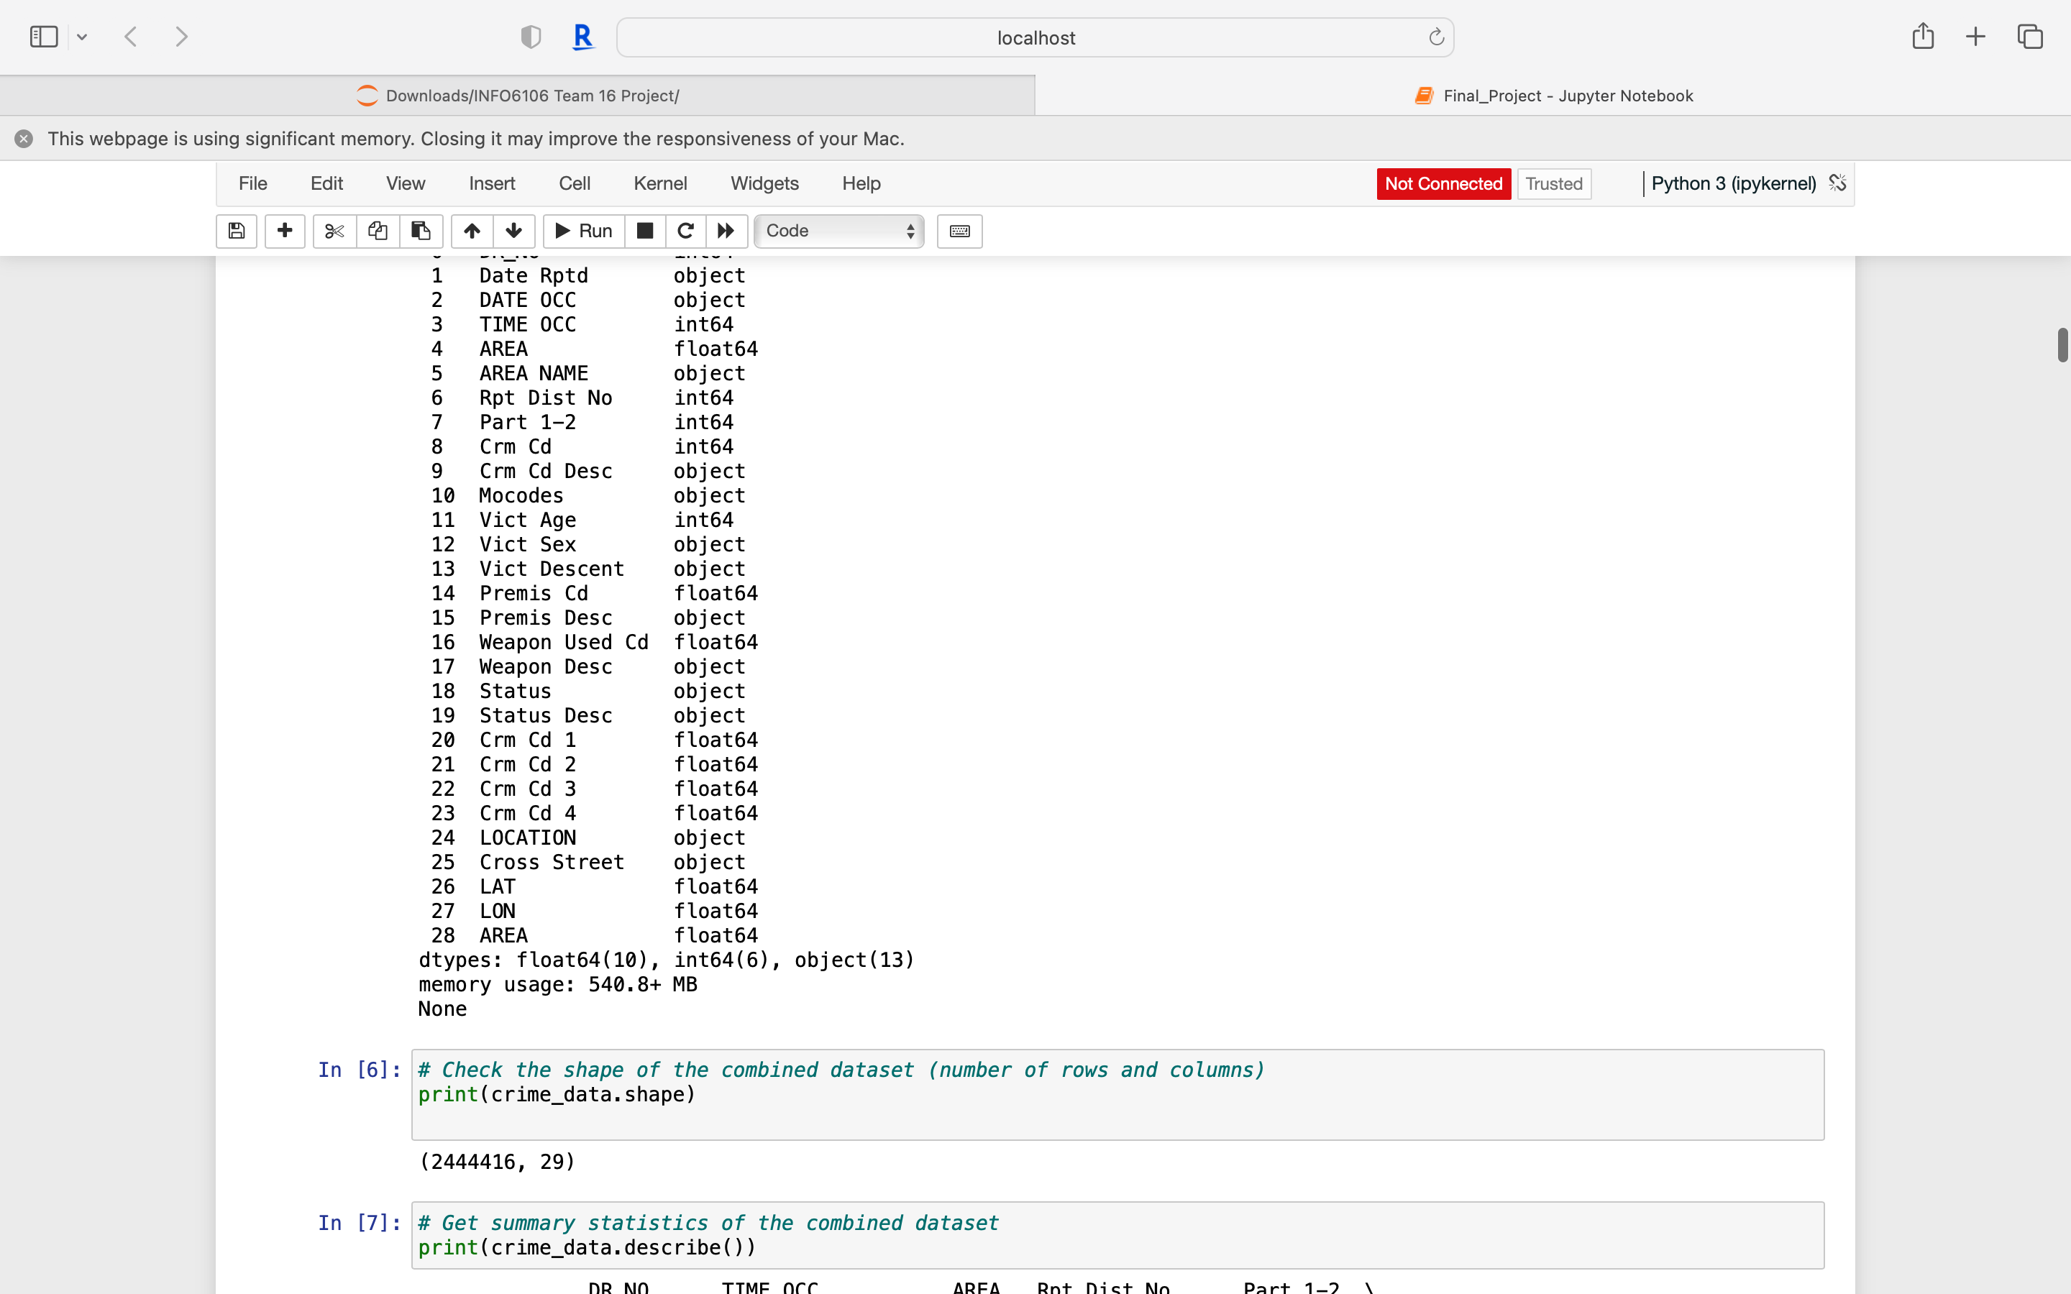
Dataset
Data was divided into two csv files: From 2010 – 2019 and then from 2020 – present

Slide 5
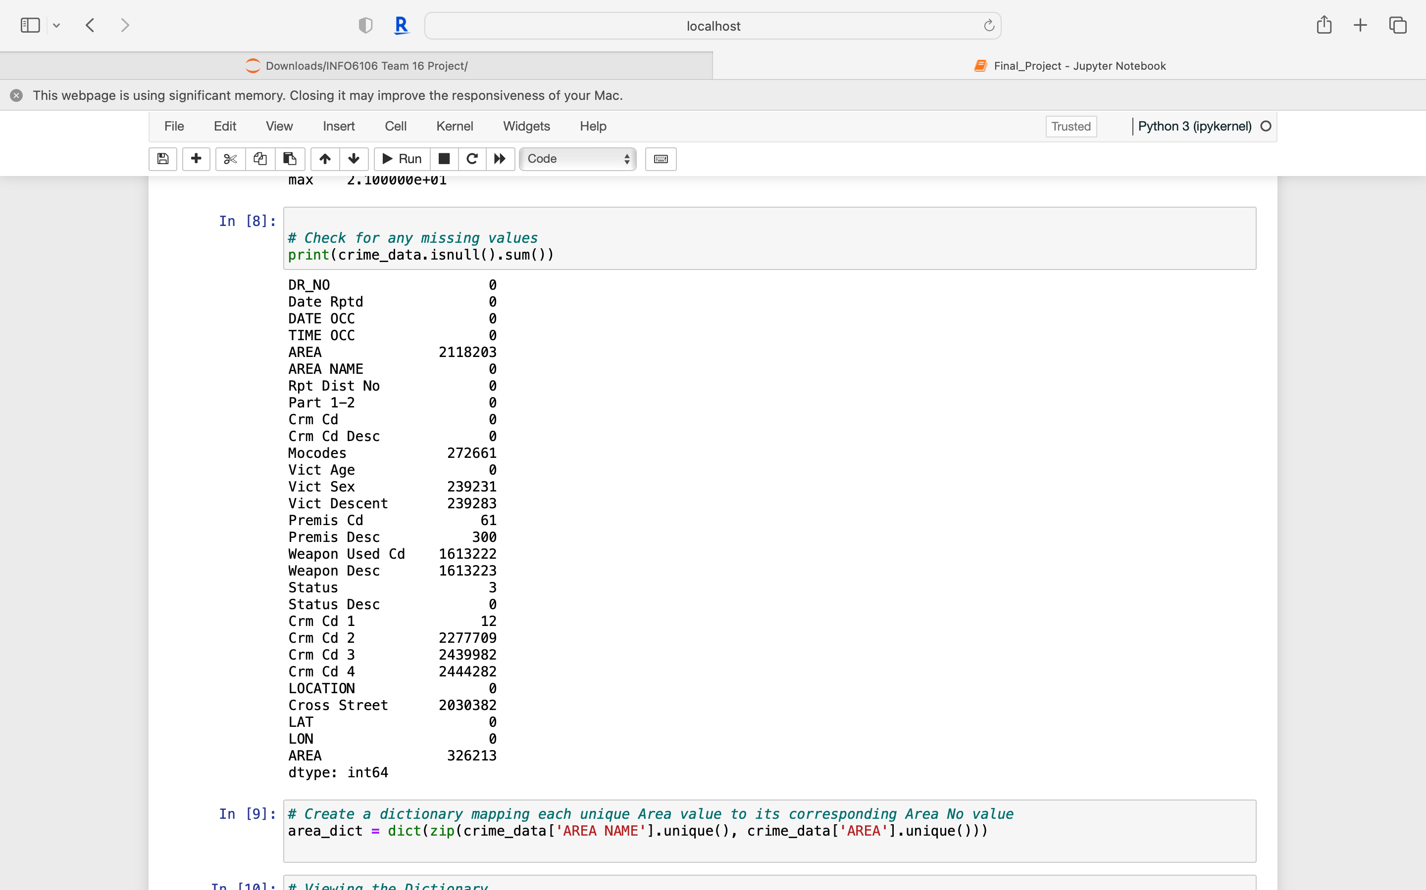
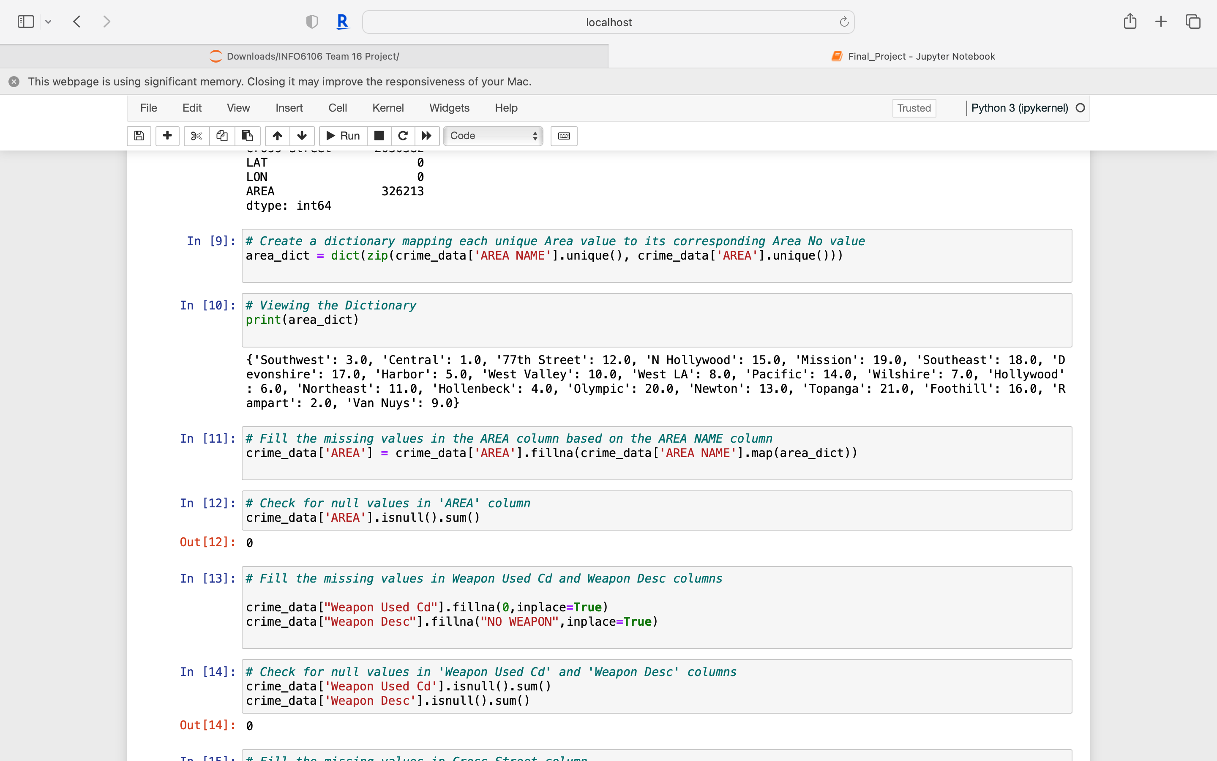
Data Cleaning
Created similar dictionaries for Weapons, Crime codes, Status & Premis code:

Slide 6
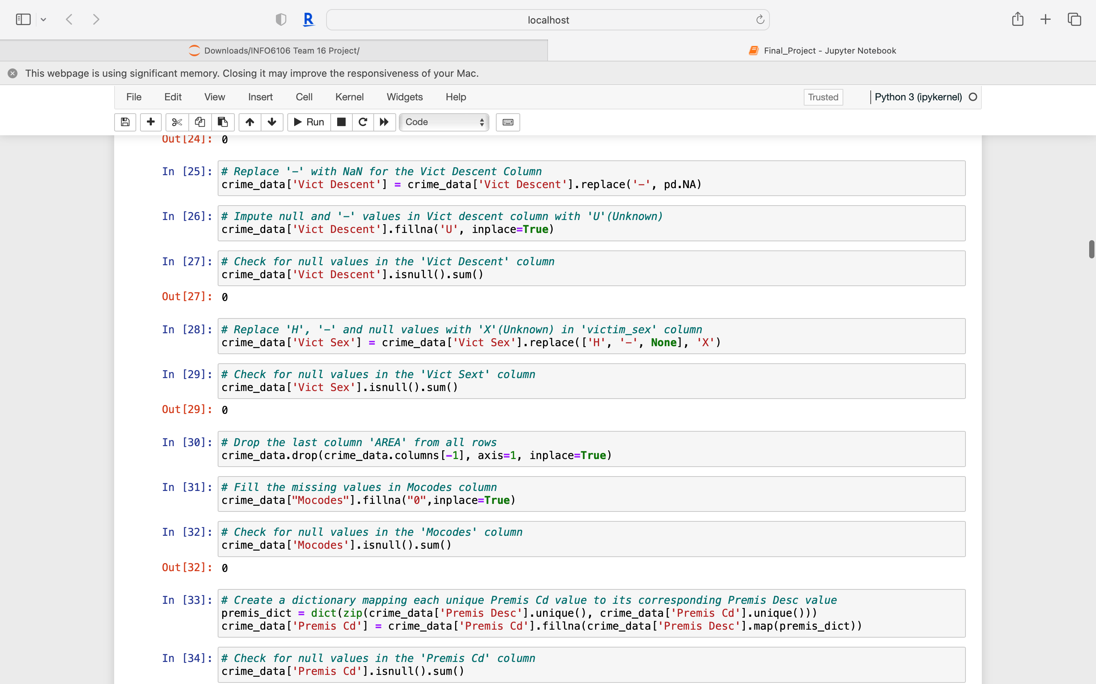
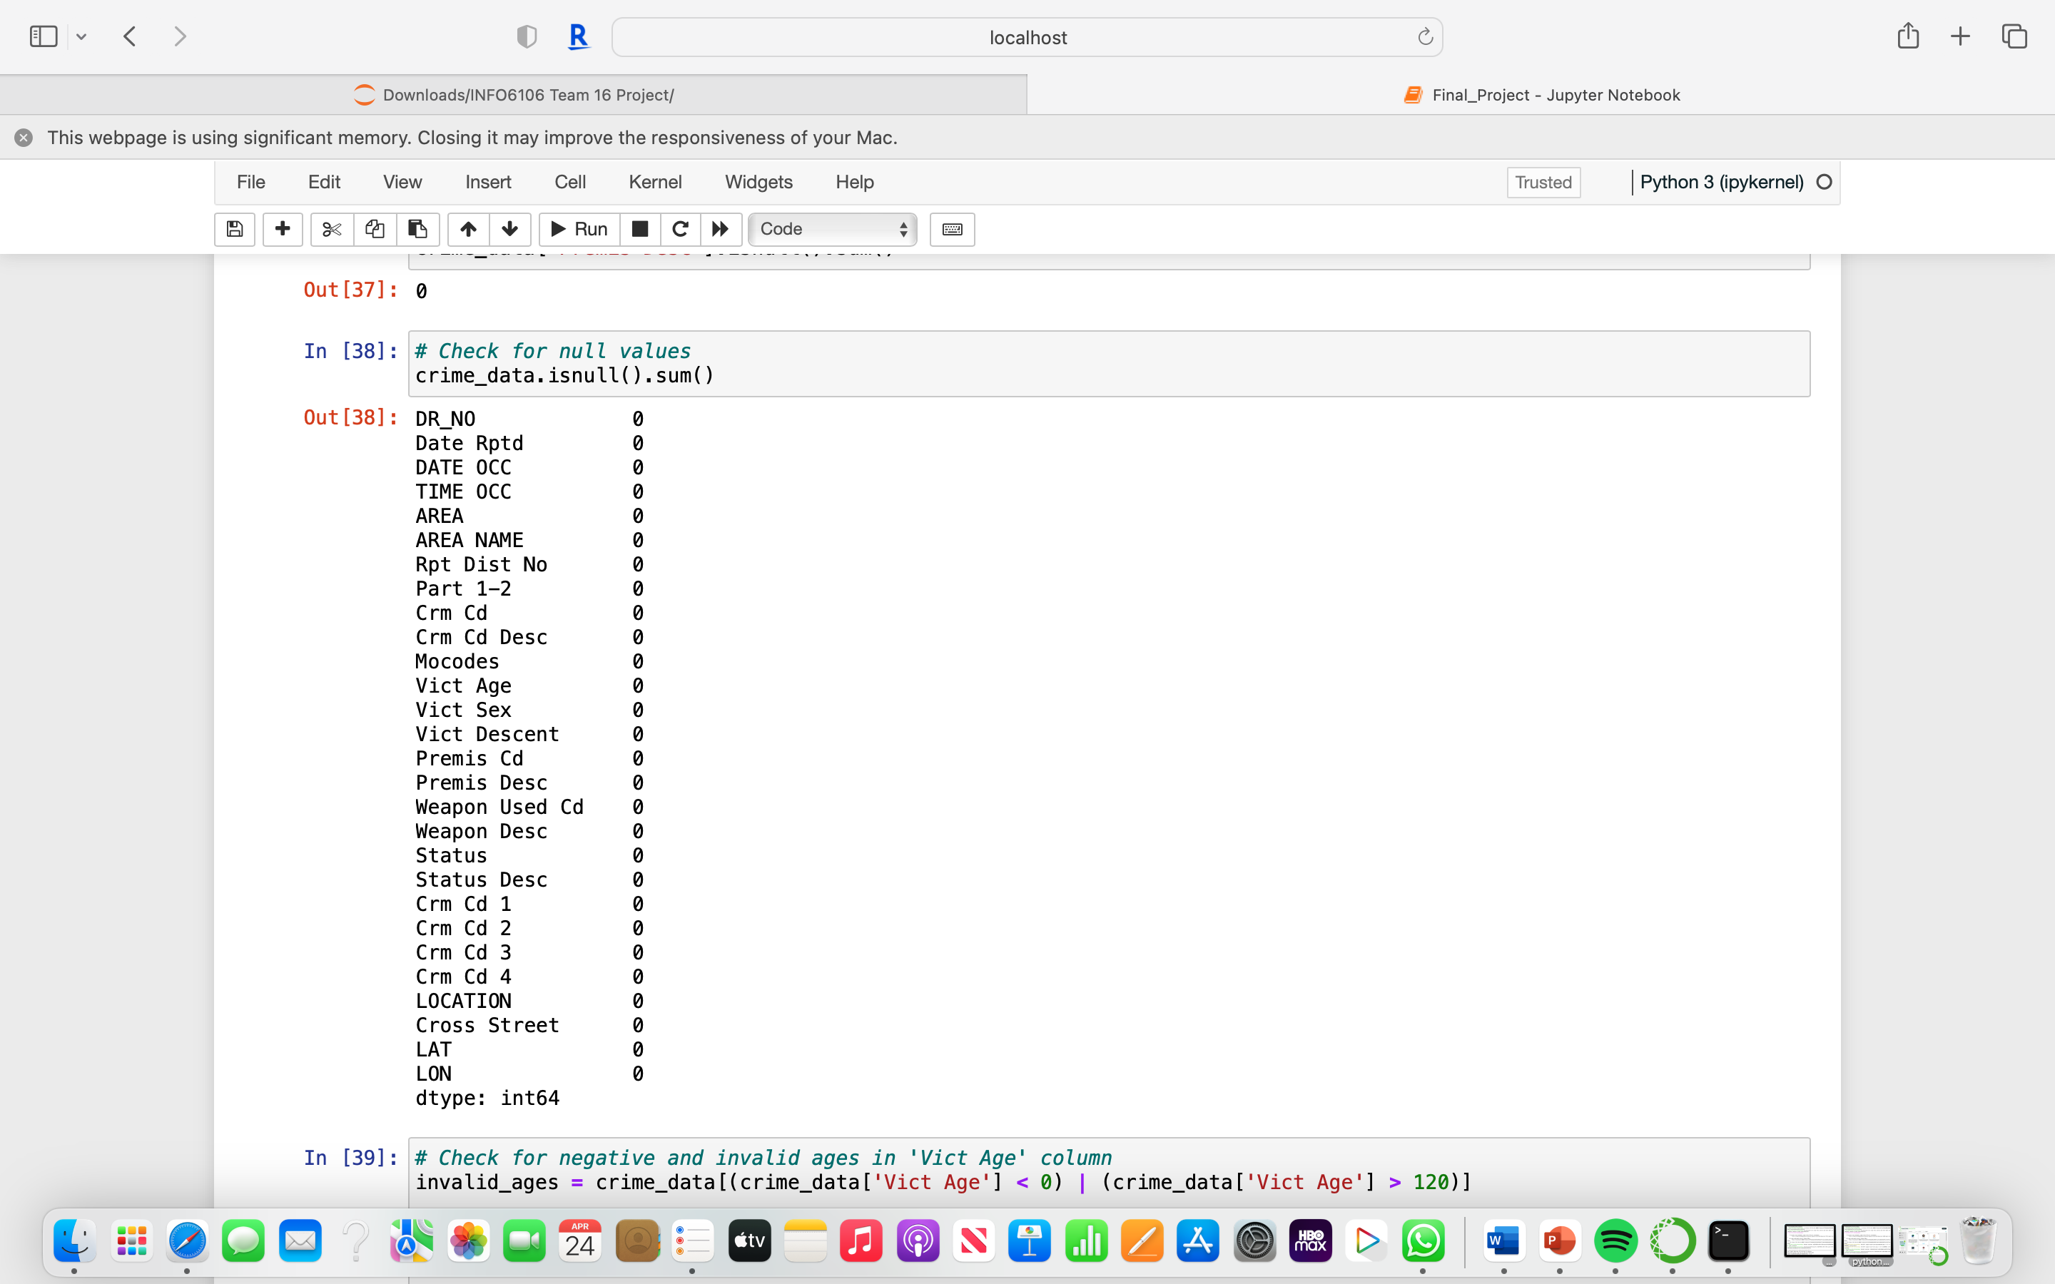
Removing null values in the Victim Descent and Victim Sex columns:

Slide 7
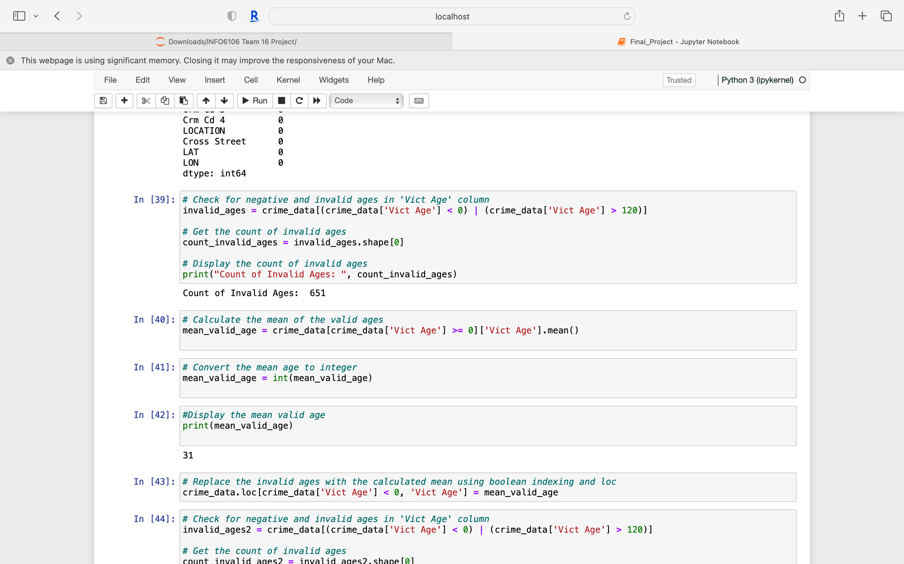
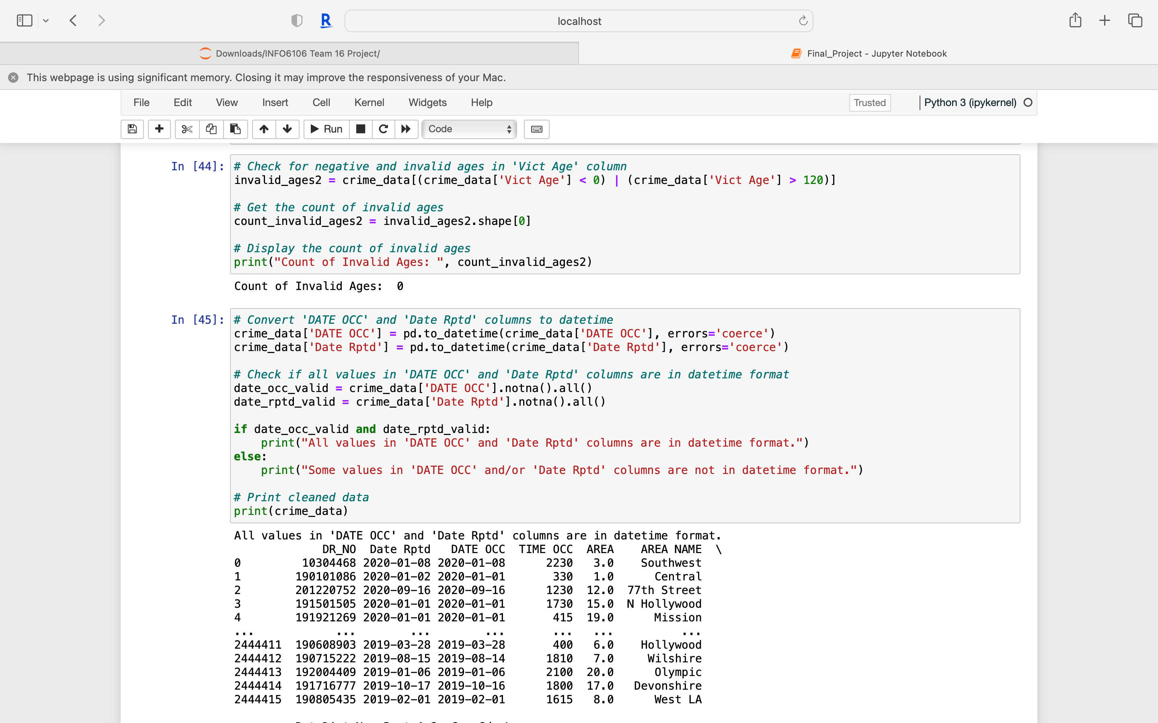
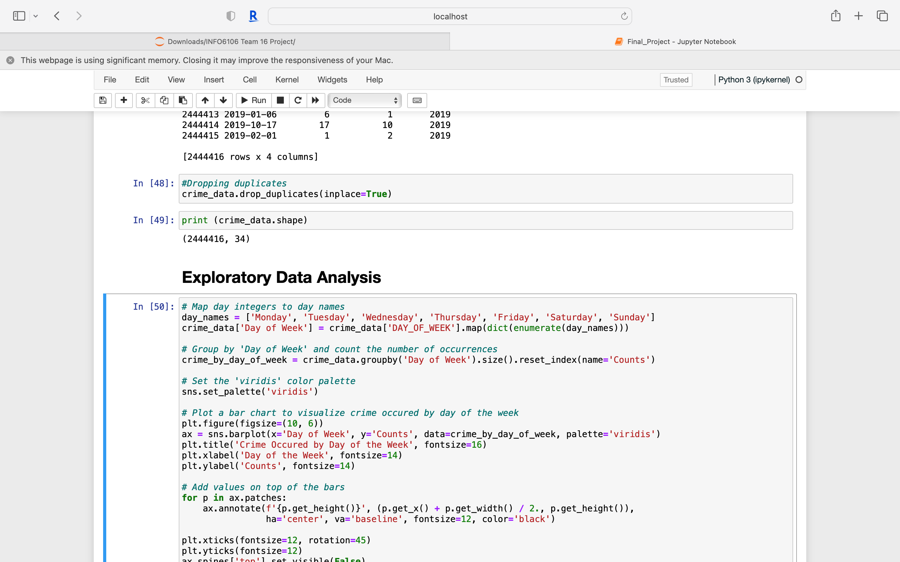
Data Preprocessing
Removing invalid and negative ages:
Setting the columns to DateTime format:
Data cleaning duplicates:

Slide 8
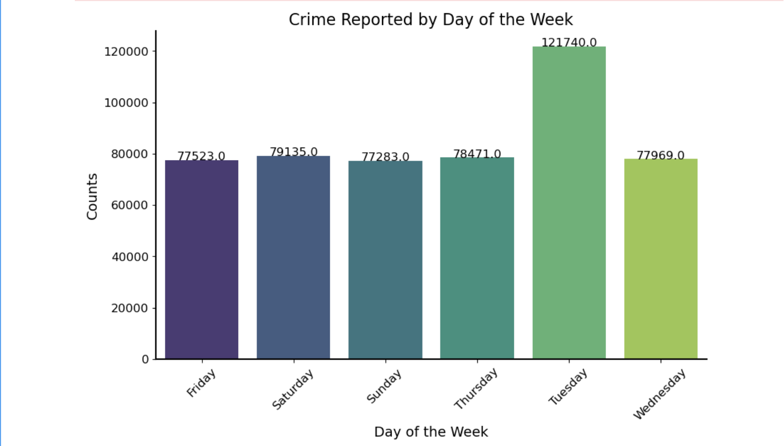
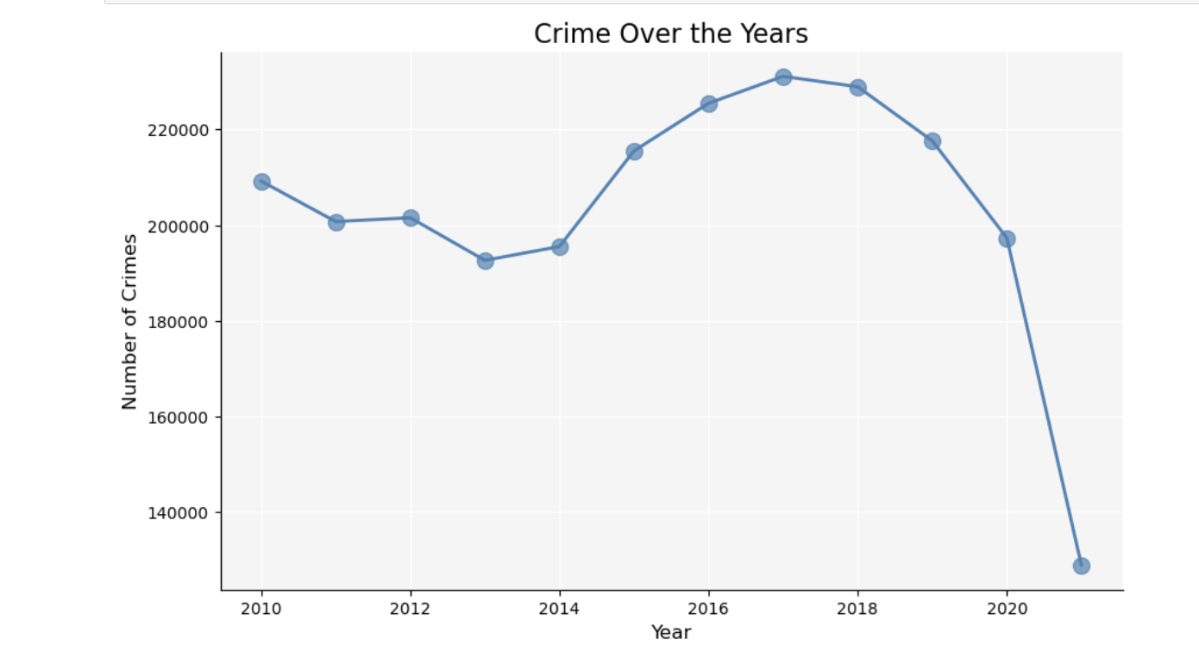
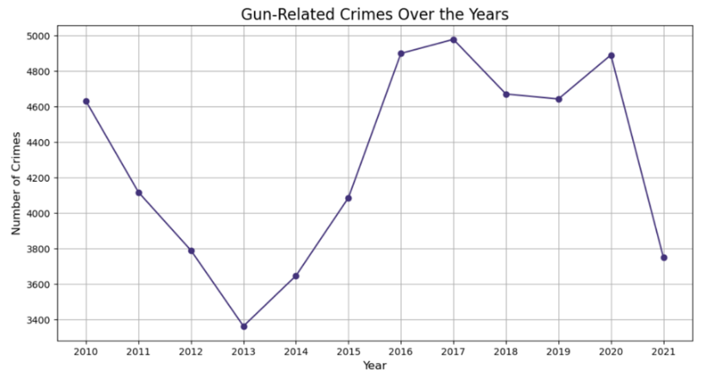
Exploratory
Data
Analysis

Slide 9
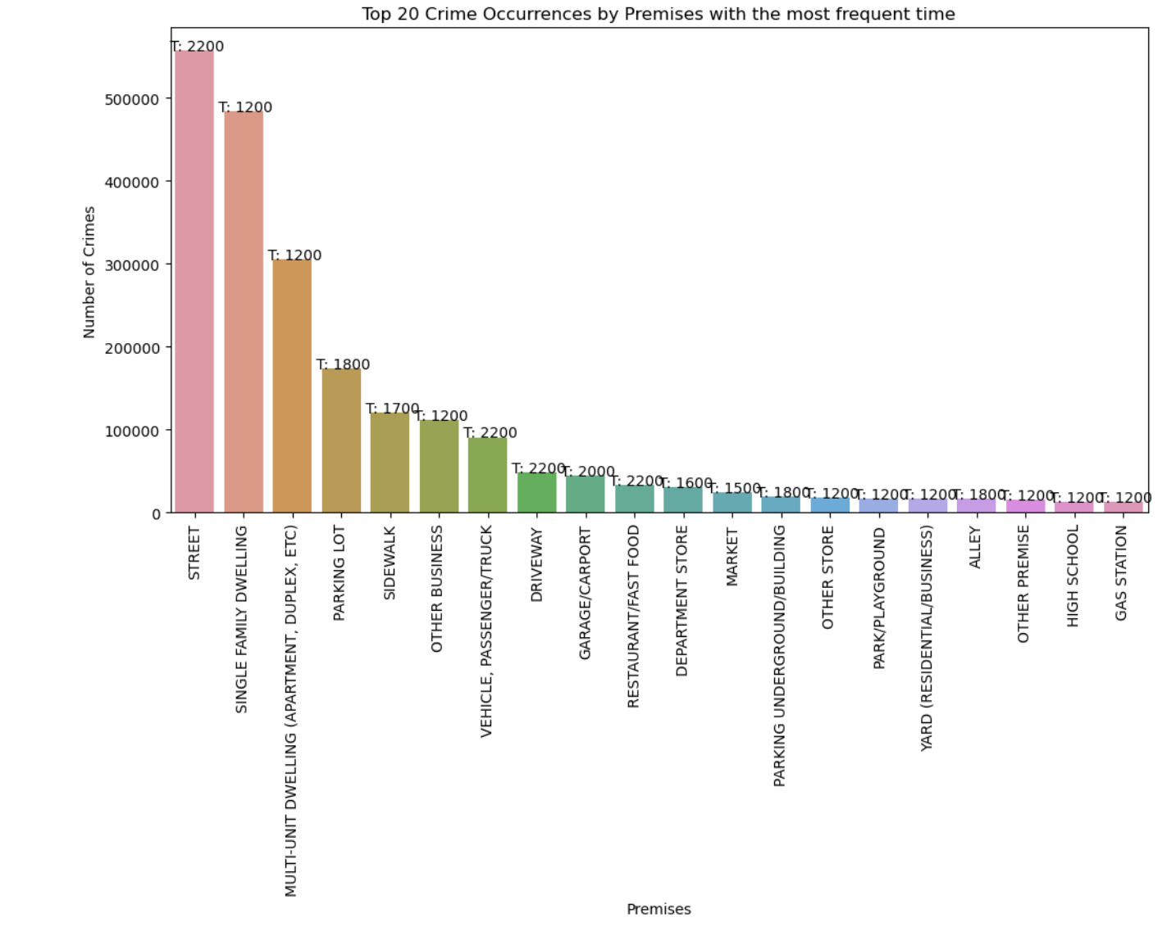
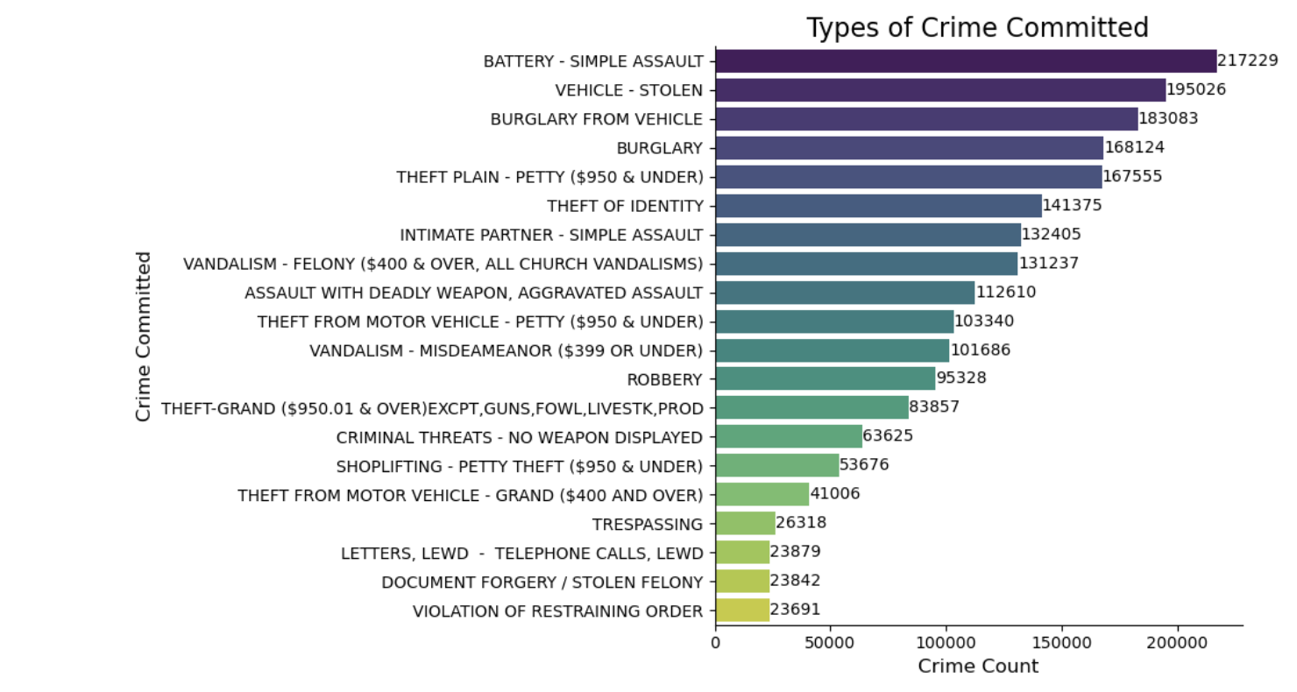

Slide 10
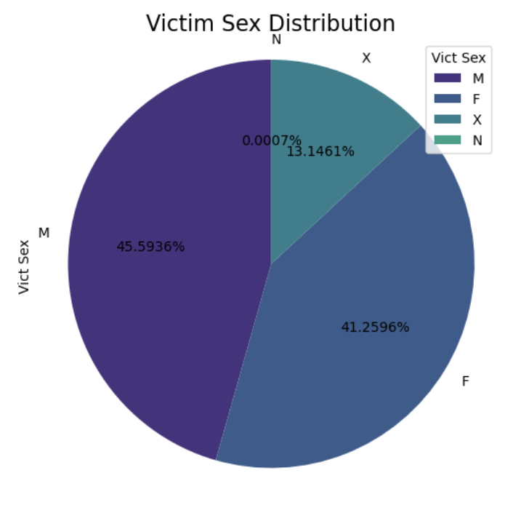
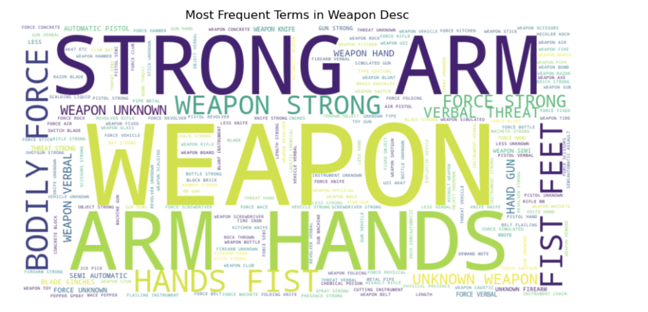
Pie Chart
of the Victim Sex
Word Cloud
of most frequent terms in Weapon Desc column

Slide 11
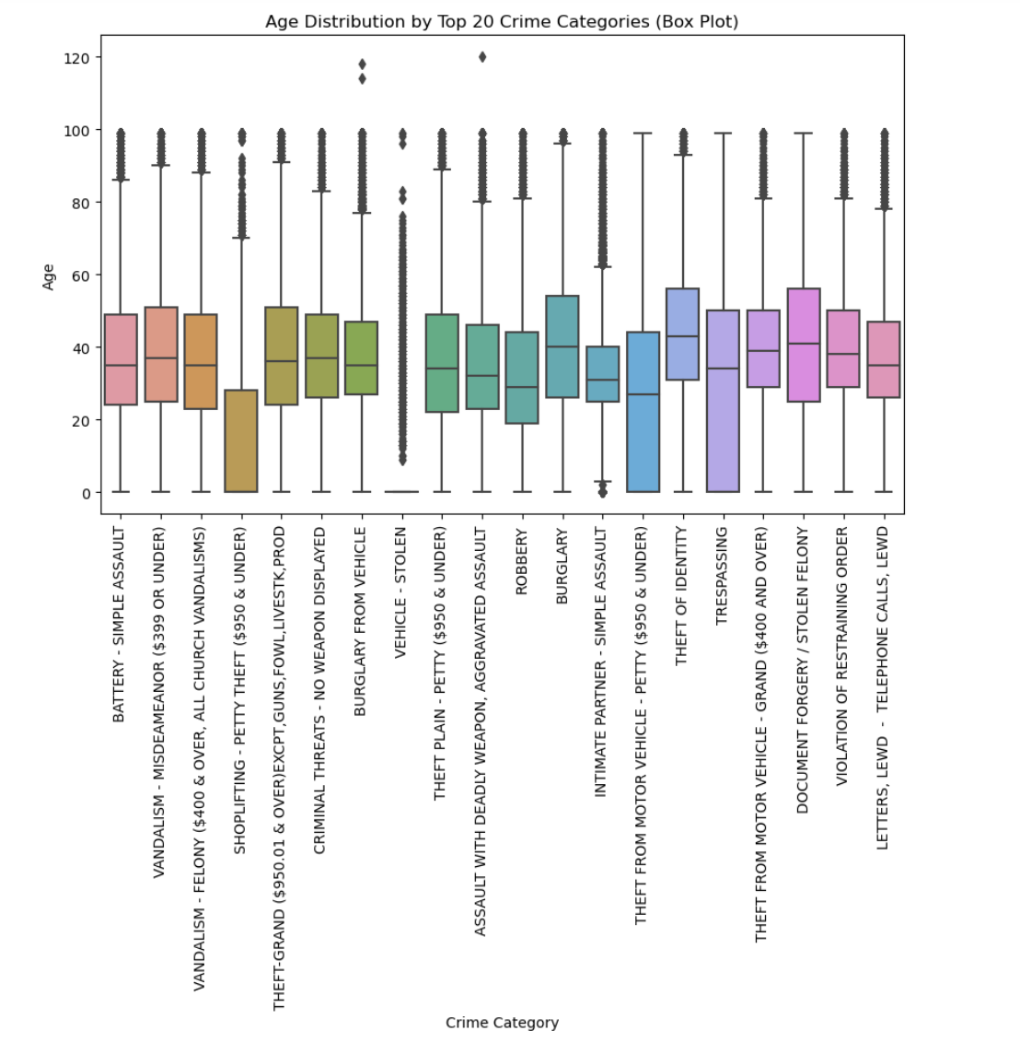
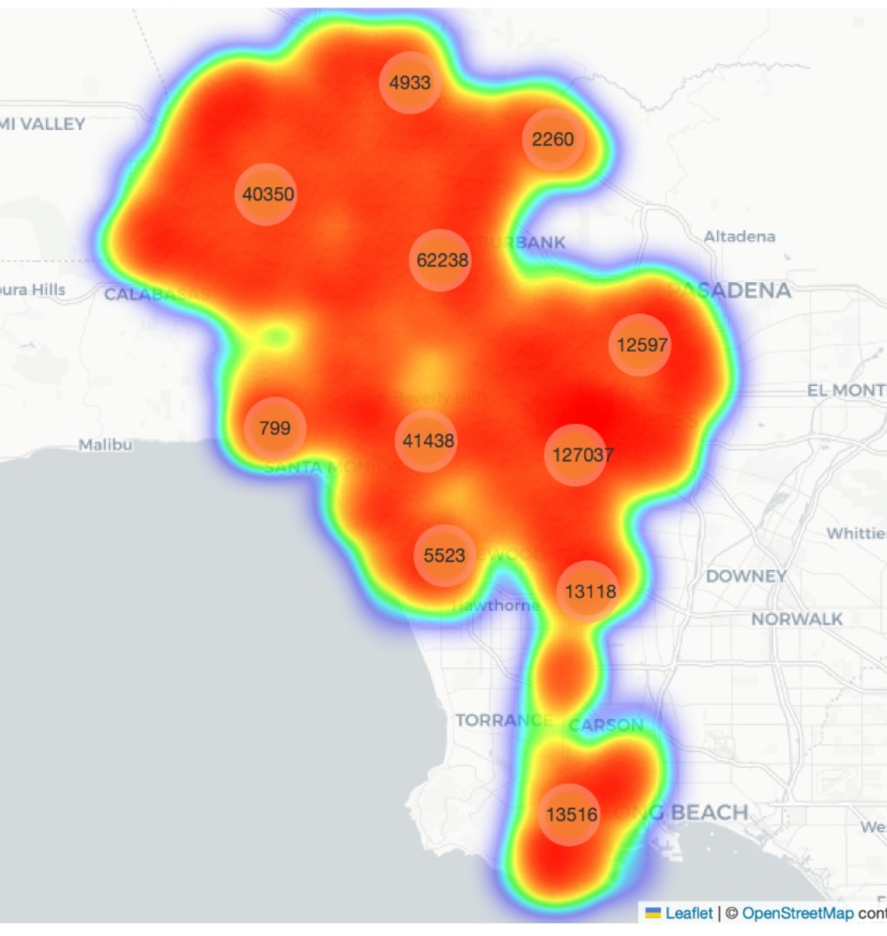
A box plot of age by crime category
Heat map of LA based-on number of crimes

Slide 12
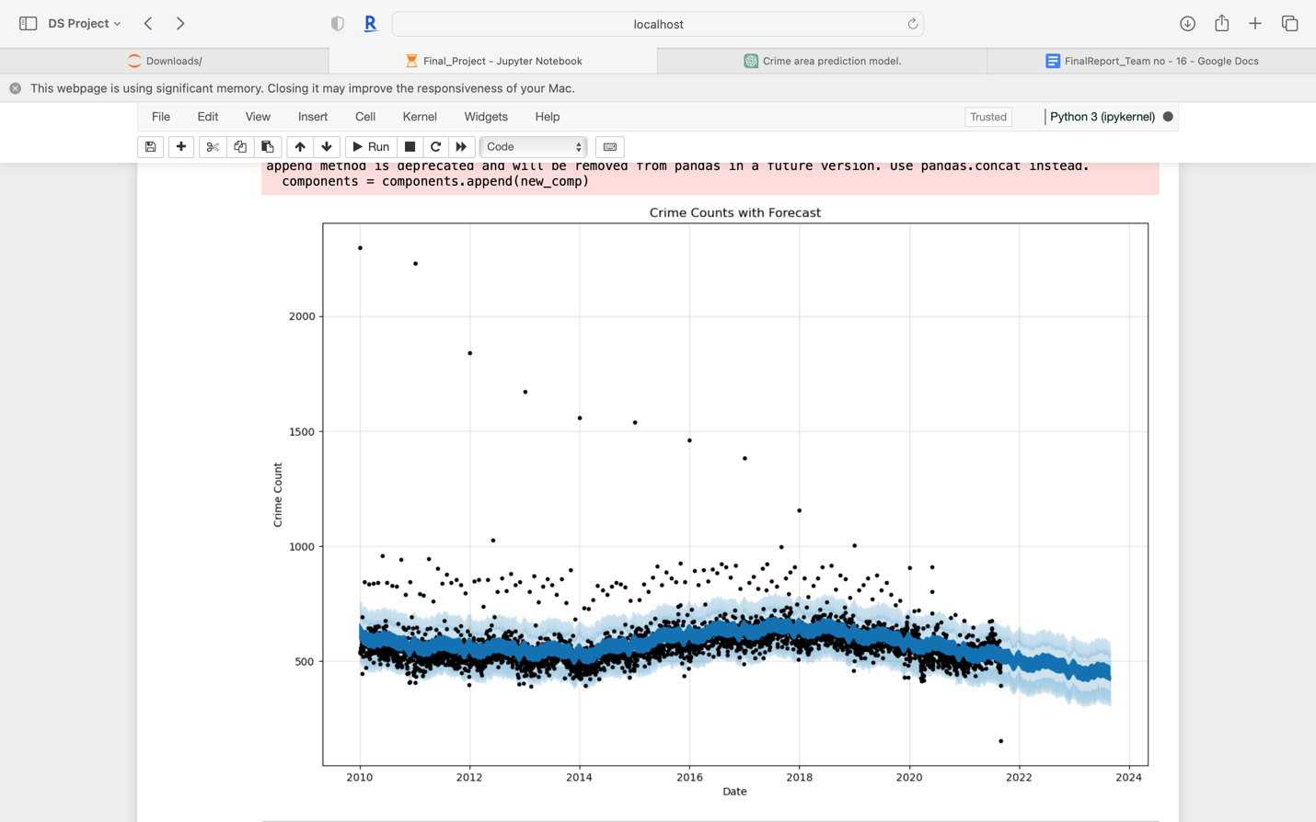
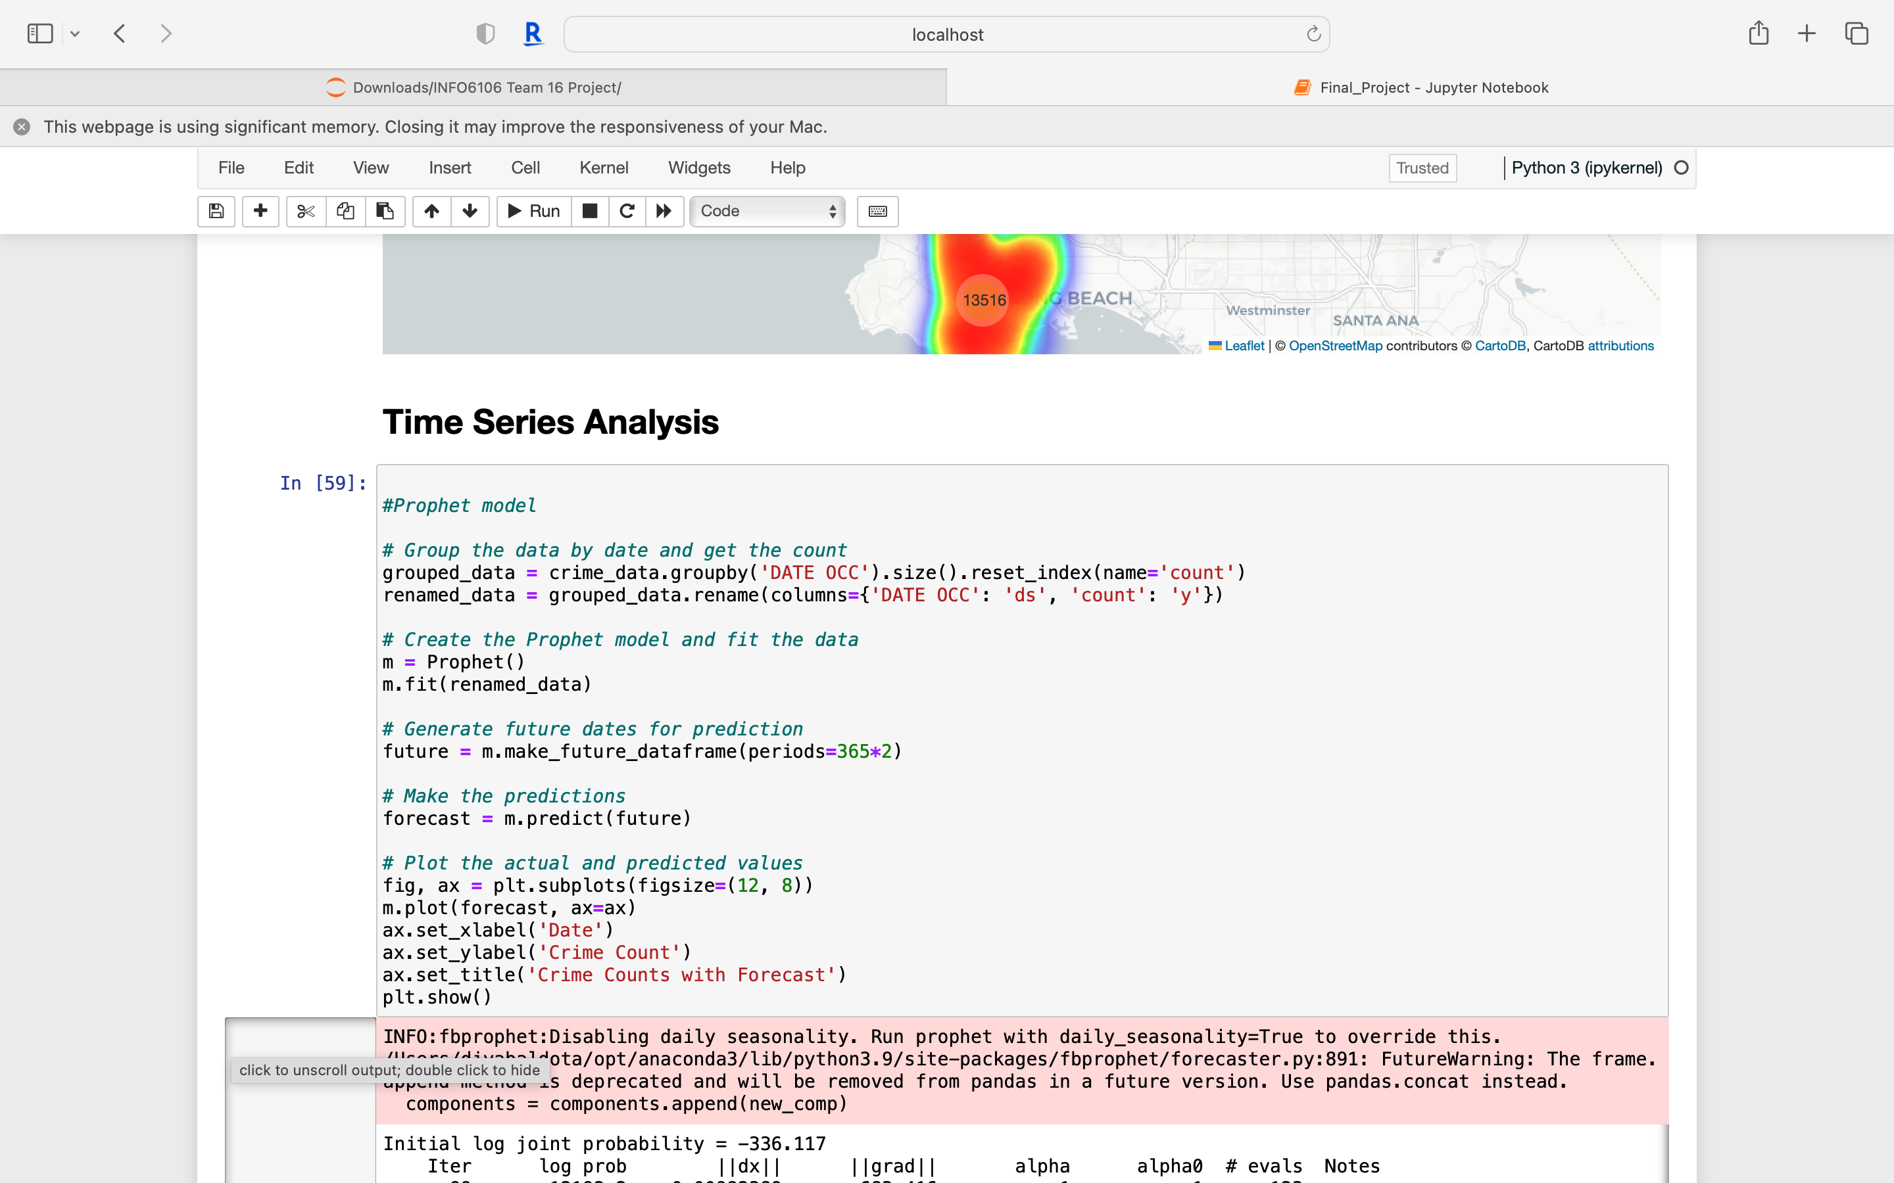
Time Series Analysis
Prophet Model
Prophet is a procedure for forecasting time series data based on an additive model where non-linear trends are fit with yearly effects.
We trained the prophet model:

Slide 13
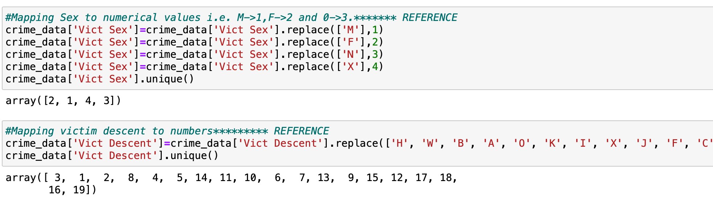
Feature Engineering
Mapping Victim Sex and Victim Descent to numerical values :

Slide 14
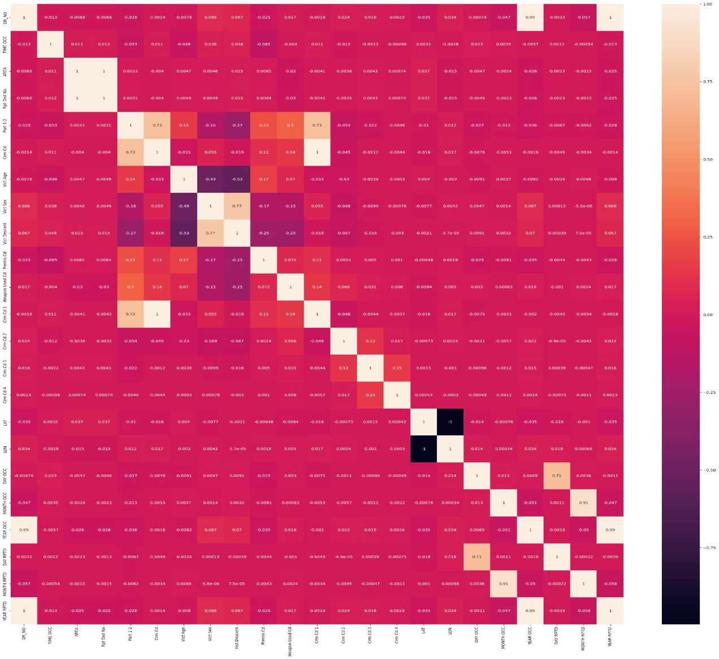
Feature Engineering
Feature engineering is the process of selecting and transforming raw data into useful features that can be used by a machine learning algorithm to improve its performance. It is a critical step in building effective predictive models.
We selected the features based on the correlation matrix, by running it with ‘AREA ’ as the target matrix.
We selected our features as –
['Rpt Dist No','LAT','Premis Cd','Vict Age','Vict Sex','Vict Descent','Time’]

Slide 15
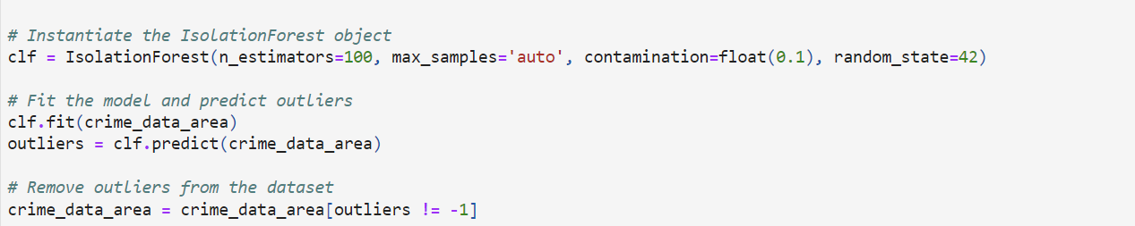
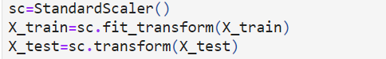
Feature Engineering
Splitting the training and testing datasets: 70-30 split
Removing outliers from the dataset: Using Isolation Forest Algorithm
Standardizing the dataset: Using the StandardScaler class

Slide 16
Model Selection
Logistic Regression
Random Forest Classifier
Decision Tree Classifier
Gaussian Naive Bayes

Slide 17
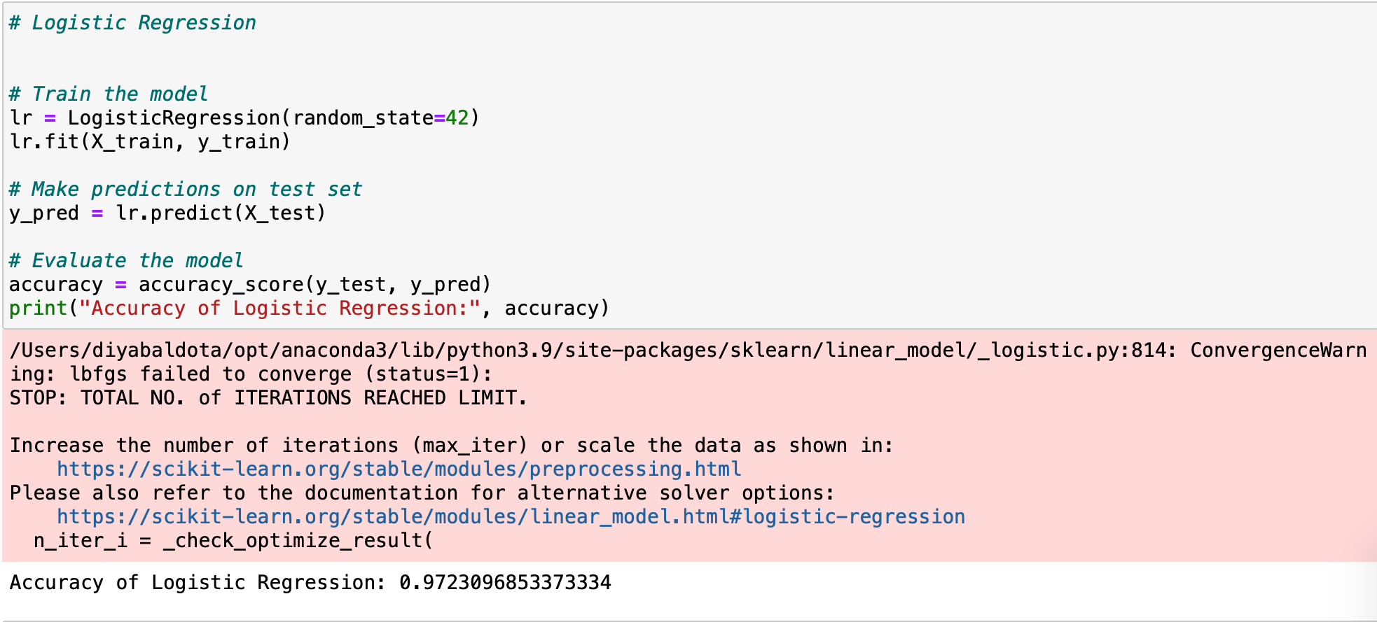
Logistic Regression
Definition: Logistic regression is a statistical algorithm used for binary classification tasks, where the goal is to predict a binary outcome (e.g., yes/no, true/false) based on a set of input features.
Overfitting: High accuracy doesn't always mean good performance. Overfitting occurs when the model is too complex and has memorized the training data instead of learning general patterns that can be applied to new data.

Slide 18
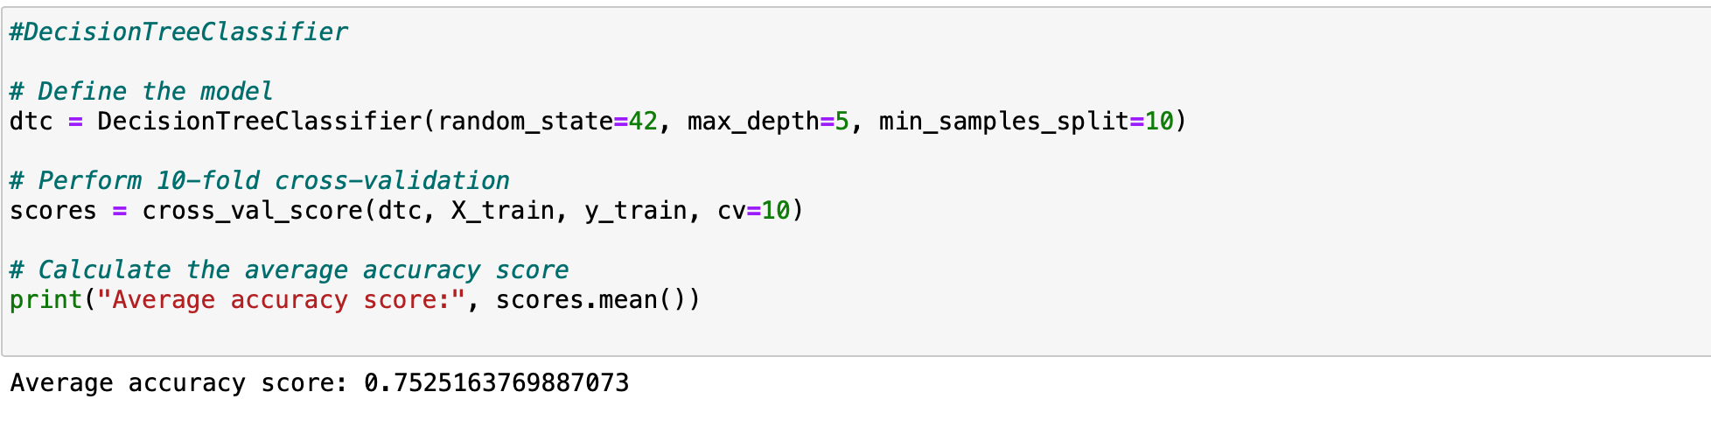
Decision Tree
The decision tree classifier used here is defined with a maximum depth of 5 and a minimum sample split of 10.
Cross-validation is a technique used to evaluate a model's performance by splitting the data into multiple subsets, training the model on some subsets, and testing it on the remaining subsets.
This code performs 10-fold cross-validation, which means that the data is split into 10 equally-sized subsets, and the model is trained and evaluated 10 times, each time using a different subset as the test set.
The performance metric used in this code is accuracy, which measures the percentage of correctly classified instances in the test set.
The average accuracy score of the decision tree classifier on the training data is 0.75, indicating that it correctly classifies 75% of the instances on average.

Slide 19
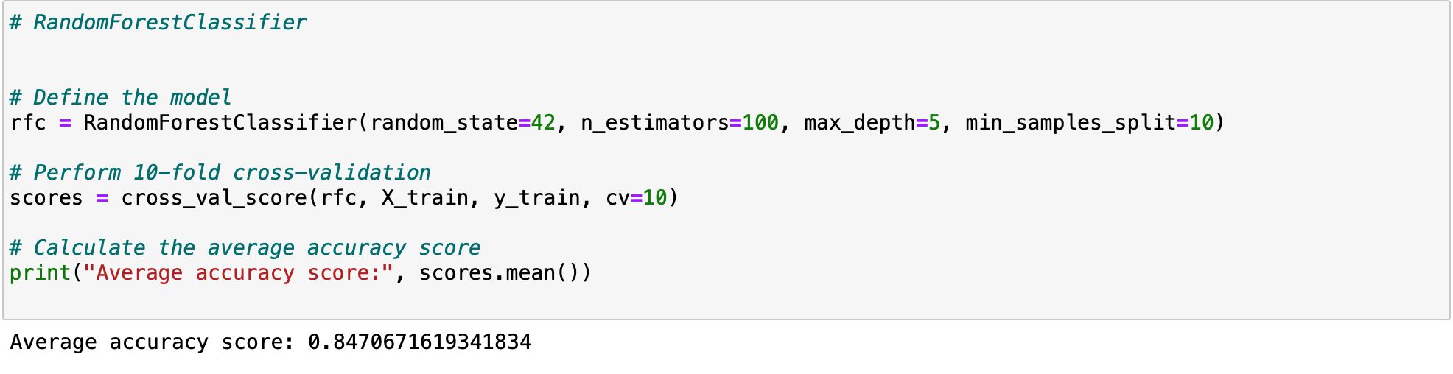
Random Forest Classifier
Random forest is a powerful model that can handle both numerical and categorical data and can also handle missing values and outliers well.
Random Forest Classifier is an ensemble learning algorithm that combines multiple decision trees to improve classification performance
In a random forest, each decision tree is trained on a random subset of the data and a random subset of the features, which helps to reduce the risk of overfitting to the training data and improve the generalization performance of the model.
The predictions of the individual decision trees are combined using a majority voting scheme to generate the final prediction.
Random Forest Classifier is a powerful and widely used algorithm for classification tasks, and it can be used for both binary and multiclass classification problems.

Slide 20
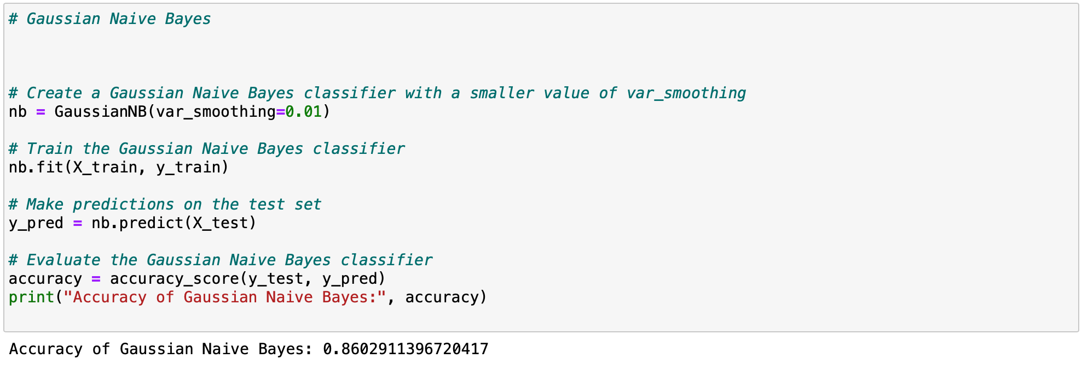
Gaussian Naïve Bayes
Gaussian Naive Bayes: Gaussian Naive Bayes is a type of Naive Bayes algorithm used for classification tasks.
It assumes that the features are normally distributed and independent of each other.
It calculates the probability of each class given the input features and selects the class with the highest probability as the prediction.
It's a simple yet powerful algorithm that works well with high-dimensional data.

Slide 21
Conclusion
Model | Accuracy
Logistic Regression | 97.2%
Decision Tree Classifier | 75.2%
Random Forest Classifier | 84.7%
Gaussian Naive Bayes | 86.0%
We conclude that, Random Forest Classifier would be an ideal model for our dataset, since
Logistic Regression is overfitting and does binary classification which is not required for our dataset
Decision Tree Classifier has an accuracy less than Random Forest Classifier
Gaussian Naive Bayes assumes that the features are independent of each other and normally distributed
In summary, we used four different machine learning models to predict the geographic area of the crime.

Slide 22
References
https://www.kaggle.com/datasets/chaitanyakck/crime-data-from-2020-to-present?resource=download
https://data.lacity.org/d/63jg-8b9z/visualization
https://github.com/SlicerBX/crime-data-analysis-and-prediction-in-LA/blob/main/Crime_Prediction_and_Classification_in_LA_Master.ipynb
https://stackoverflow.com/questions/48085110/no-module-named-folium-plugins-python-3-6
https://www.researchgate.net/publication/224346385_Forecasting_crime_using_the_ARIMA_model

Slide 23
Thank you

